Slide 1


CAPSTONE PROJECT
Airline Customer Behavior Analytics Dashboard using Power BI
Presented By
Student Name: Subhasish sahoo
College Name:KIIT
Department:ECSE
Email ID:sahoorahul377@gmail.com

Slide 2
OUTLINE:
Problem Statement
Proposed System/Solution
System Development Approach
Algorithm & Deployment
Result (Output Image)
Conclusion
Future Scope
References

Slide 3
Problem Statement:
Airlines handle a large number of passengers every day, making it difficult to understand customer behavior and satisfaction levels. Passenger experience is influenced by several factors such as travel class, service quality, and flight delays.
Although airlines collect a huge amount of passenger data, it is not easy to extract meaningful insights from the raw data without proper analytical tools. Understanding what affects passenger satisfaction is important for improving airline services and enhancing the overall travel experience.
Therefore, there is a need for a system that can analyze passenger data and provide clear insights into customer behavior and service performance

Slide 4
Proposed Solution:
Airlines handle a large number of passengers every day, making it difficult to understand customer behavior and satisfaction levels. Passenger experience is influenced by several factors such as travel class, service quality, and flight delays.
Although airlines collect a huge amount of passenger data, it is not easy to extract meaningful insights from the raw data without proper analytical tools. Understanding what affects passenger satisfaction is important for improving airline services and enhancing the overall travel experience.
Therefore, there is a need for a system that can analyze passenger data and provide clear insights into customer behavior and service performance

Slide 5
System Approach:
The project was developed using Power BI, which is a powerful tool for data analysis and visualization.
The development process included the following steps:
Collecting the airline passenger dataset.
Cleaning and preparing the dataset using Power Query.
Creating additional columns to better analyze passenger behavior.
Developing analytical measures using DAX.
Designing an interactive dashboard with multiple visualizations.
Tools Used
• Power BI Desktop – Dashboard creation and data visualization • Power Query – Data cleaning and transformation • DAX – Creating calculated measures and metrics

Slide 6
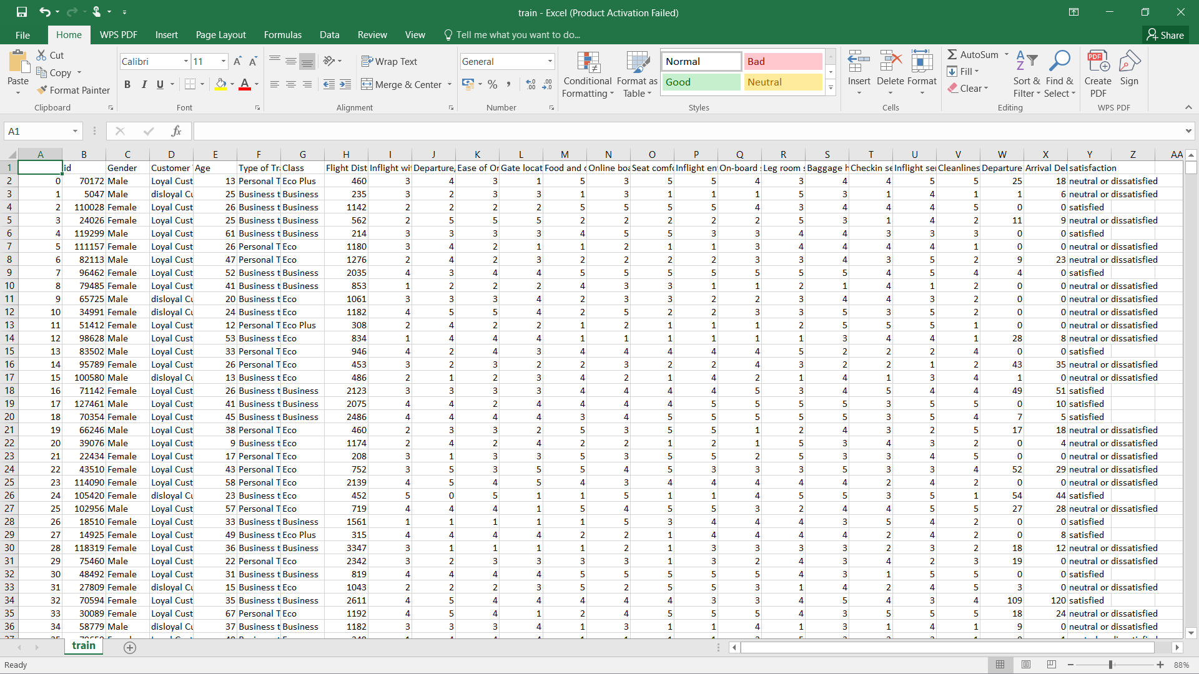
System Approach:
Airline Passenger Satisfaction Dataset

Slide 7
Algorithm & Deployment:
Before building the dashboard, the dataset was cleaned and transformed to make it suitable for analysis.
Data preprocessing involved checking column data types, handling missing values, and preparing the dataset for visualization.
Two additional columns were created to improve analysis:
• Delay Category – to classify flights into On Time, Minor Delay, Moderate Delay, and Severe Delay. • Age Group – to categorize passengers based on age.
These columns help analyze customer behavior more effectively.
Several DAX measures were also created to calculate key metrics such as total passengers, average flight delay, average flight distance, and satisfaction rate.

Slide 8
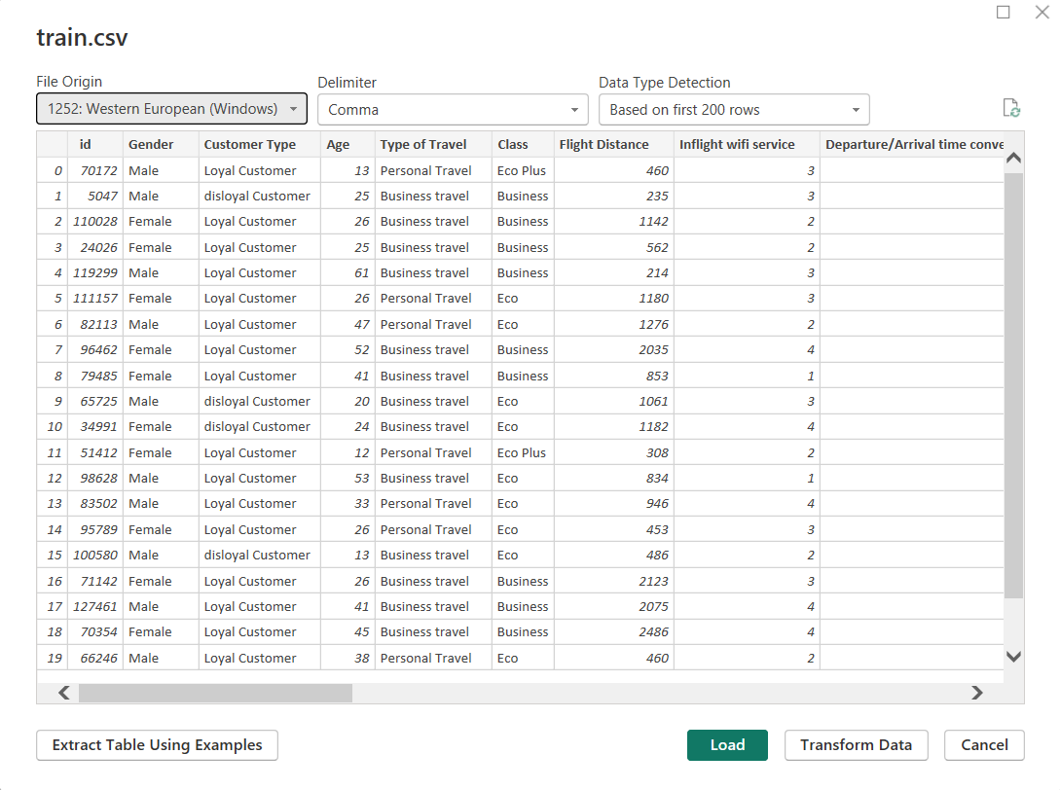
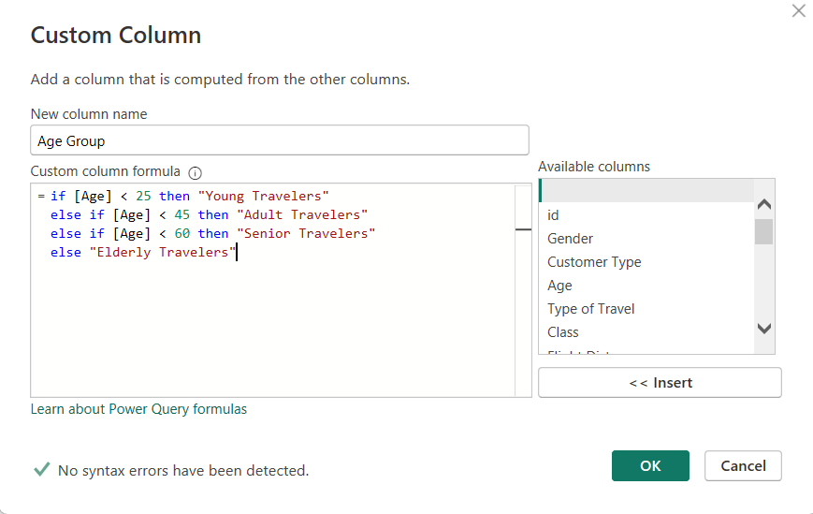
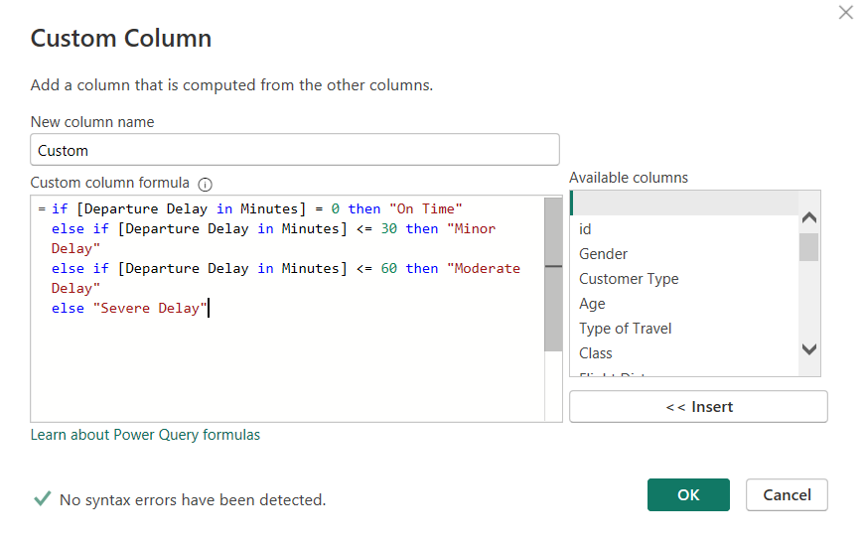
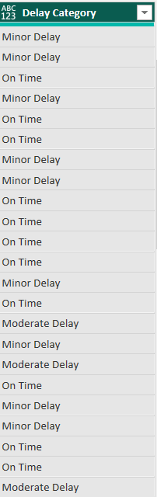
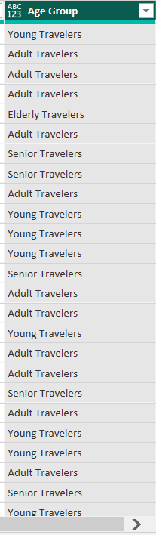
Algorithm & Deployment:
Feature Engineering – Delay Category & Age Group
Data Cleaning using Power Query

Slide 9
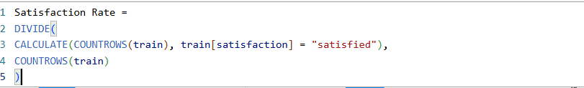
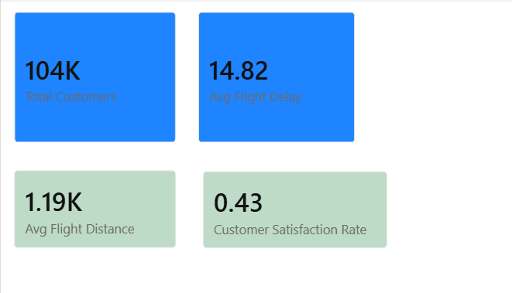
Algorithm & Deployment:
Measures the overall customer satisfaction level.
Used to understand typical travel distance patterns.
Helps analyze the overall delay experienced by passengers.
Used to show the total number of passengers in KPI cards and charts.
DAX Measures for Customer Analytics
DAX measures were created to calculate key performance indicators such as total passengers, average delay, average flight distance, and passenger satisfaction rate. These measures help analyze airline passenger behavior and service performance through interactive visualizations.

Slide 10
Result:
The Power BI dashboard provides several visualizations that help understand passenger behavior and satisfaction.
The dashboard includes charts that show the distribution of satisfied and dissatisfied passengers, the difference between loyal and disloyal customers, and how flight delays affect passenger satisfaction.
It also highlights how service quality factors such as seat comfort and inflight service influence the passenger experience.
These visual insights make it easier to understand patterns in the data and identify areas where airlines can improve their services.

Slide 11
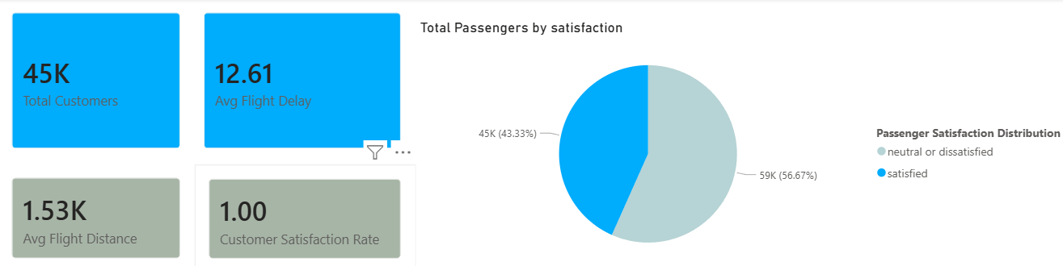
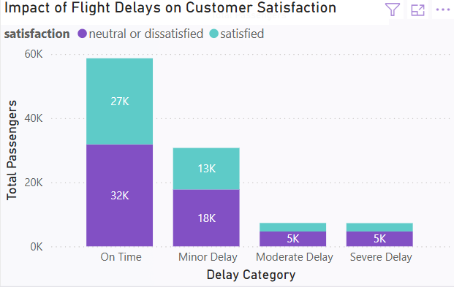
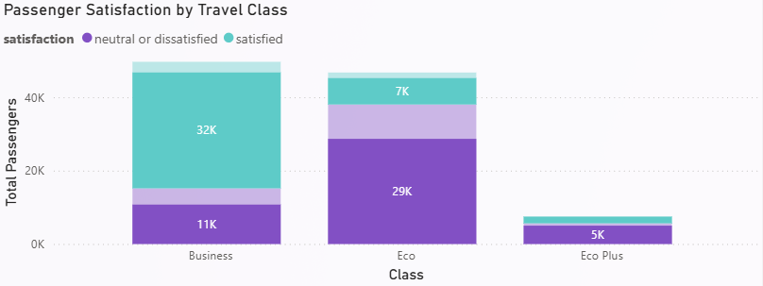
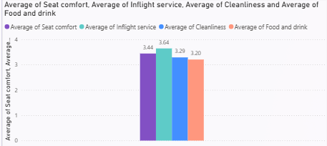
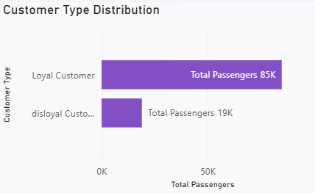
Result:

Slide 12
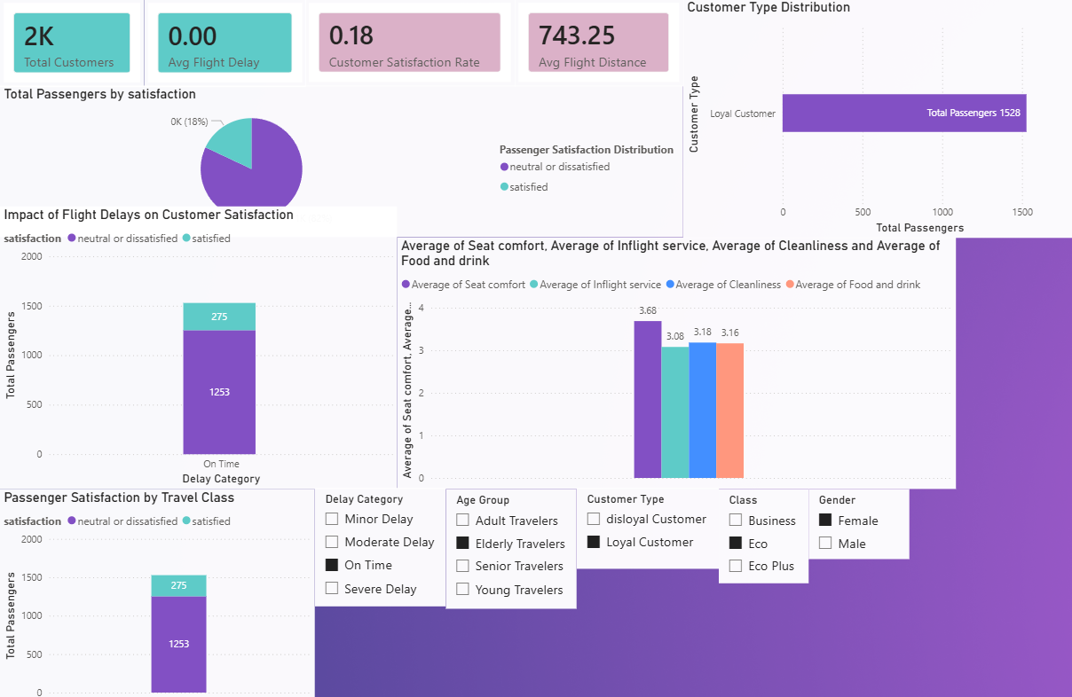
Result:
The final Power BI dashboard provides a comprehensive overview of airline passenger behavior and service quality. The dashboard integrates multiple visualizations and key performance indicators to help analyze passenger satisfaction and operational factors affecting customer experience.
The dashboard highlights important metrics such as total passengers, average flight delay, average flight distance, and overall satisfaction rate. It also includes charts that show passenger satisfaction distribution, customer type distribution, and the impact of flight delays on passenger satisfaction.
Interactive filters allow users to explore the dataset by gender, customer type, travel class, age group, and delay category. These filters enable deeper analysis of different passenger segments and help identify patterns in customer behavior.
The dashboard provides valuable insights that can help airline companies understand passenger expectations and improve service quality.

Slide 13
Conclusion:
This project demonstrates how Power BI can be used to analyze airline passenger data and gain valuable insights into customer behavior and service quality.
The dashboard highlights important factors that affect passenger satisfaction, such as travel class, service ratings, and flight delays. By visualizing this information clearly, the dashboard helps airlines understand passenger expectations and improve their services.
Overall, the project shows how data analytics can support better decision-making and enhance the passenger experience

Slide 14
Future scope:
In the future, the project can be expanded by integrating real-time airline operational data. Advanced analytics techniques such as machine learning could also be used to predict passenger satisfaction and flight delays.
Additional datasets could be included to provide deeper insights into airline performance and customer behavior.
LINK FOR THE POWER BI FILE :LINK
LINK FOR THE ppt: LINK

Slide 15
References:
Airline Passenger Satisfaction Dataset Kaggle https://www.kaggle.com/datasets/teejmahal20/airline-passenger-satisfaction
Microsoft Power BI Documentation https://learn.microsoft.com/en-us/power-bi/
Power BI Data Visualization Guide https://learn.microsoft.com/en-us/power-bi/visuals/power-bi-report-add-visualizations
DAX (Data Analysis Expressions) Documentation https://learn.microsoft.com/en-us/dax/

Slide 16
Thank You

